Slide 1
Work System Design Lab
Measurement and analysis of ergonomics variable with.

Slide 2
Measurement and analysis of ergonomic variables with
Cord binding tester
Depth Perception Meter
Bolt Stand

Slide 3
How to measure eye fatigue?
The eye fatigue is calculated before the experiment.
Average Fatigue:
S. No. | R | 60-R
1. | 38 | 22
2. | 37 | 23
3. | 39 | 21
4. | 38 | 22
5. | 38 | 22

Slide 4
Study on Cord Binding tester
Objectives:
To measure the speed of a subjects hand and finger movement (efficiency)
To test the movement and muscular coordination of the body of the subject.
To measure the learning rate of the subject.
Equipment Required:
Cord Binding Experiment board.
Cord
Stop Watch
Recording Sheets
Eye fatigue tester.

Slide 5
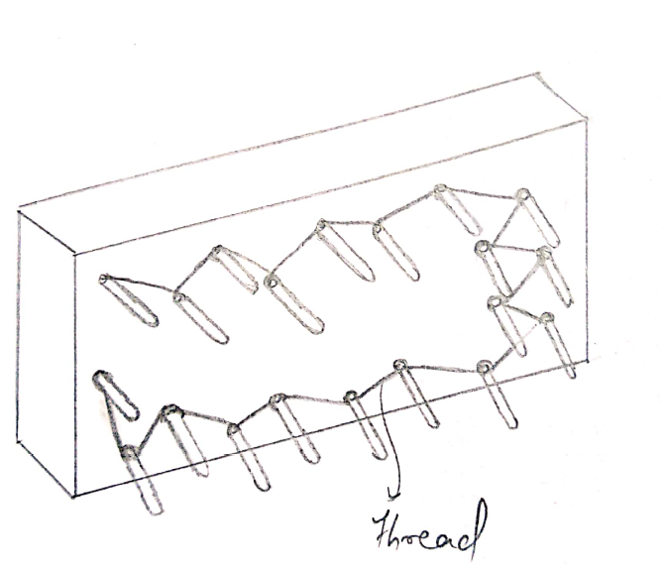
Operation: 1. Eye Fatigue test is recorded before the experiment. 2. The operation of cord binding is done in sequence. 3. Time taken to complete the binding is recorded. 4. The experiment is repeated 2 to 3 times for 30 cycle. 5. The eye fatigue test is tested after the experiment. Diagram:

Slide 6
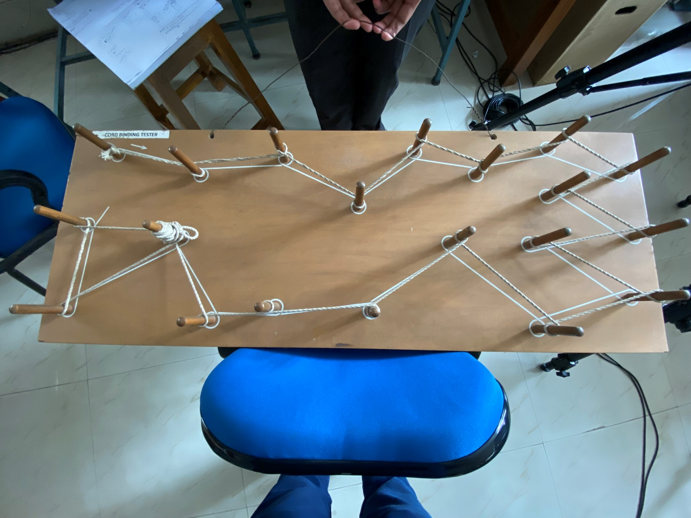
Cord Binding

Slide 7
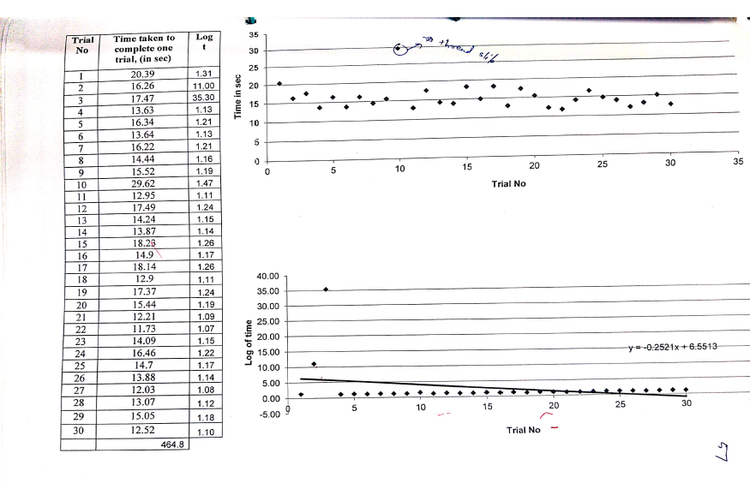
Data

Slide 8
Study of Depth Perception Meter
Objectives:
1. To measure depth perception of a subject with respect to specified arrangements.
2. To assess the depth perception of the subject.
3. To measure the learning rate of the subject for this job.
Measuring Instruments:
1. Digital Flicker Visual Fatigue tester.
2. Depth Measuring scale in perception tester.
Operation:
The subject should be at specific position and adjust the chin rest to bring the eyes of subject to about same position as deep hole of tester.
The power should be switch on and let subject hold the grip button of the reaction signal cord.

Slide 9
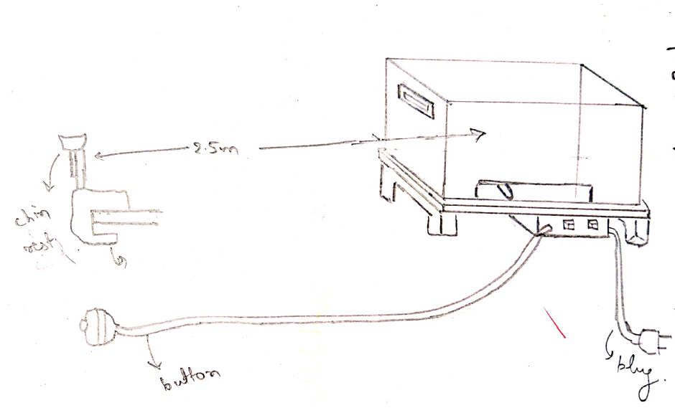
Depth perception tester Contd..
The speed selection switch should be set at 25 mm/sec. The direction lever should be moved from left to right position.
The other person will move the direction indicator lever to the direction of the mean position.
When the mean position is reached then activates the reaction button.
The deviation from the mean position is measured on the measuring scale of tester.
Repeat the process for 30 more cycles.
Diagram:

Slide 10
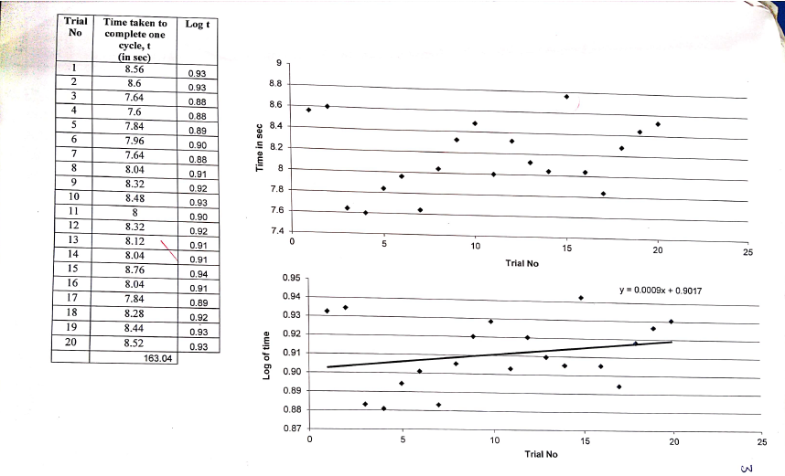
Data:

Slide 11
Bolt Stand
Objective:
To measure the speed of the subject hand and finger movement( Efficiency)
To Test the movement and muscular coordination of the body of the subject.
To measure the learning rate of the subject.
Equipments Required:
Bolt
Bolt Stand
Stop Watch
Fatique Tester
Operation:
1. The visual fatigue test is recorded in the start of experiment.

Slide 12
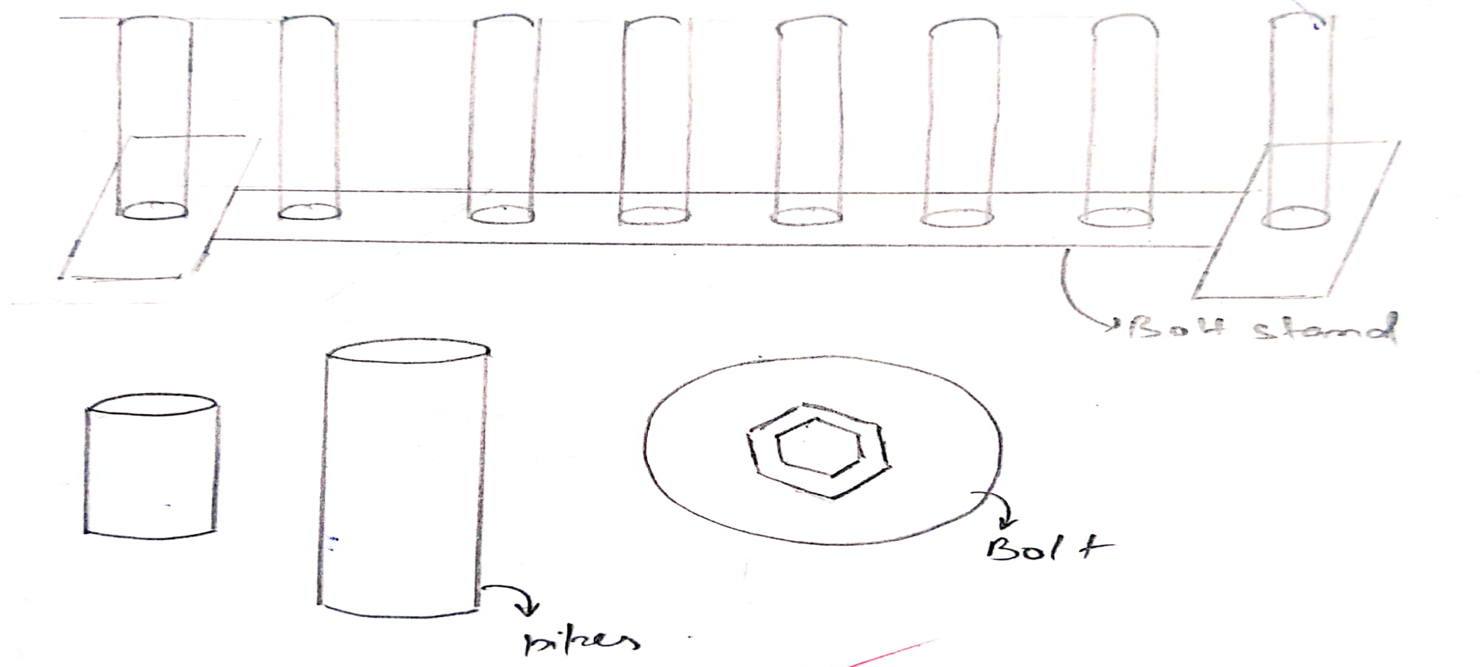
Bolt Stand Contd..
2. Time taken to make the assembly bolt is recorded.
3. The experiment is repeated for 15 times.
4. The visual fatigue test is recorded at the end of experiment.
Diagram:

Slide 13
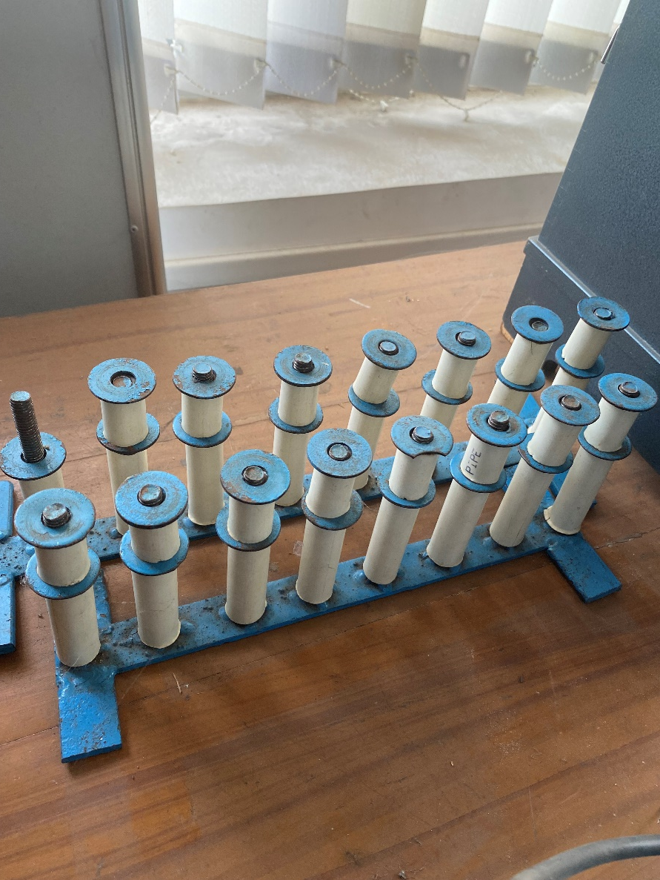
Bolt Stand

Slide 14
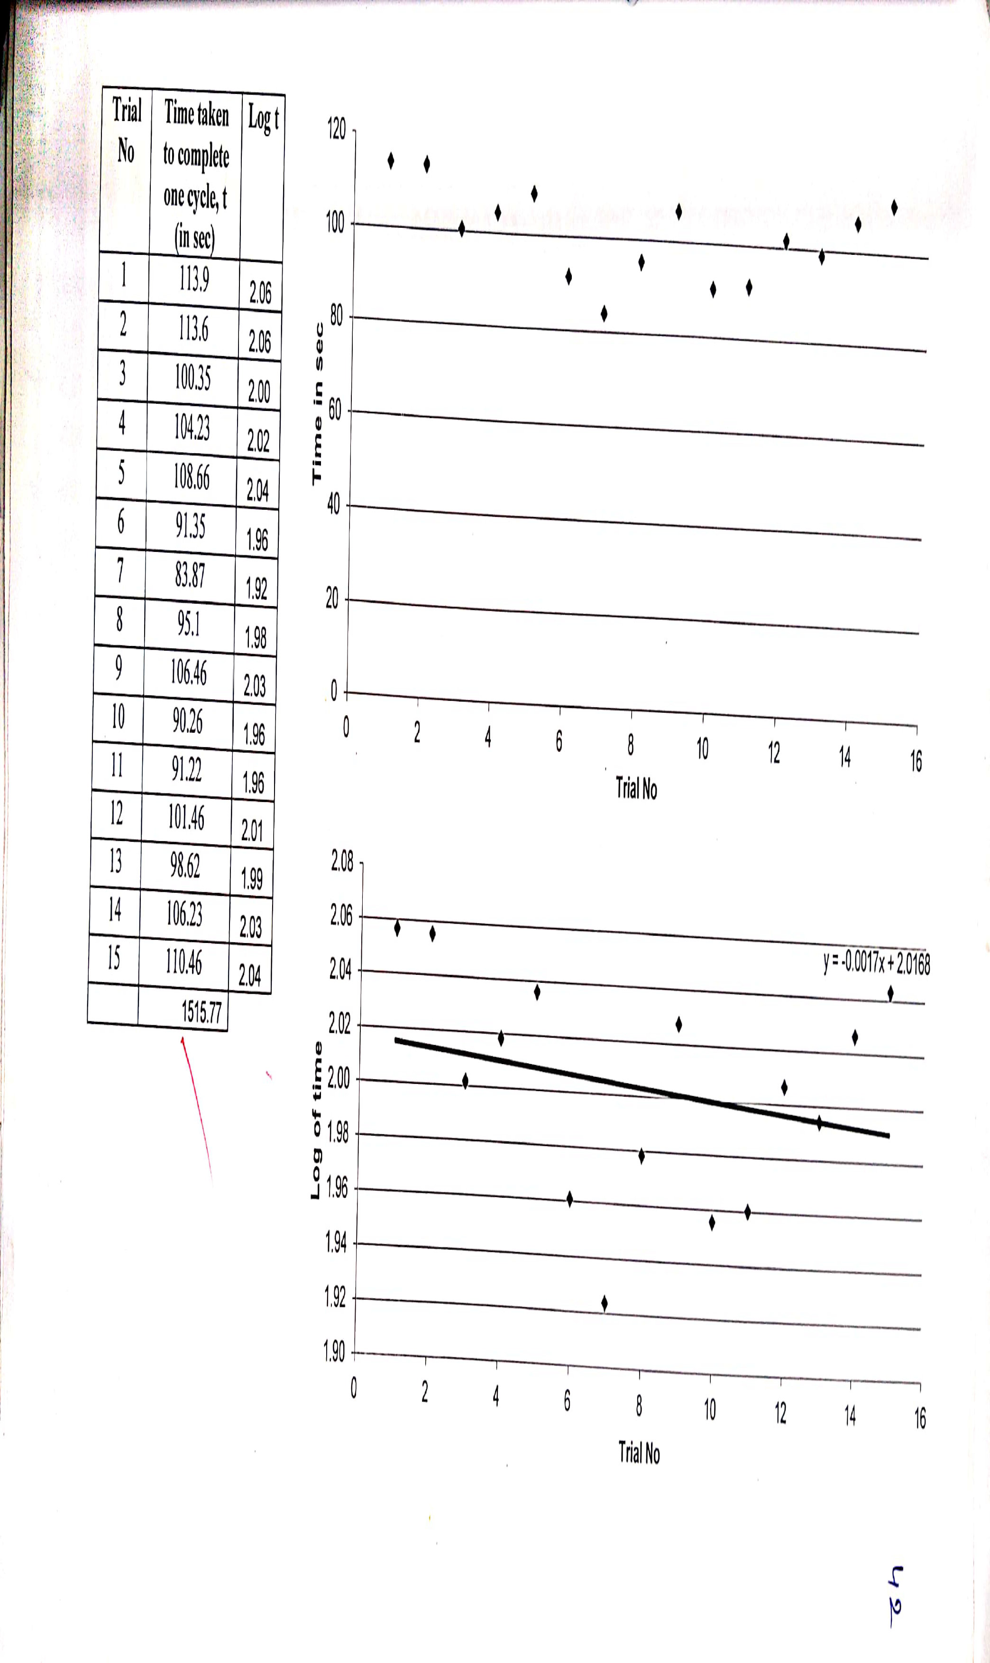
Data:

